Slide 1
Who am i?
A brief explanation of my life.

Slide 2
My name is Juan Manuel Tenorio
21 y/o
Im from Cali but currently living in Bogota
Im single
I live with my mom and siblings
I have a dog and a cat but im mostly a cat person
I studied culinary arts at Mariano Moreno Institute also Software engineering at Escuela de Ingenieros Julio Garavito but only completed the first semester.
I love listening to all kinds of music but I prefer hip hop and alternative rock over other genres.
Cooking while listening to music brings joy and peace to my life.
My favourite colors are Red and black.
The food I like the most is Italian food, like spaguetti, pizza or anything that has cheese and tomatos.
I prefer animals over people.
Most time im watching youtube/ twitch streams

Slide 3
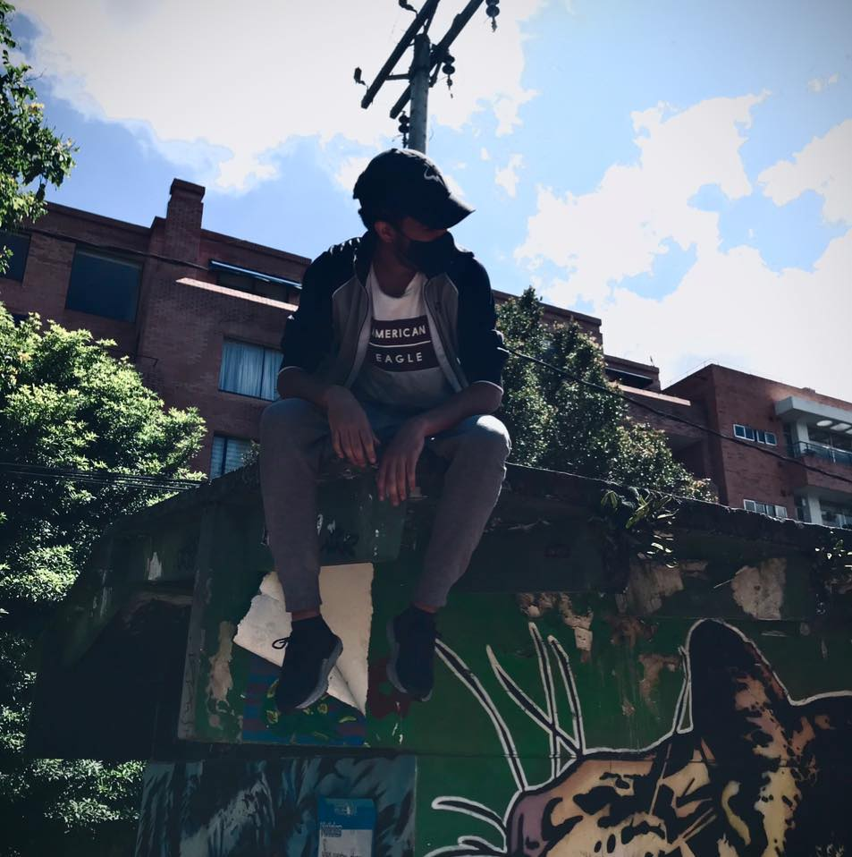
The day this foto was taken I was chilling with my homies riding bycicle. We went to Alcala park and then to the National park.

